Slide 1
VISUAL C#.NET session three
Instructor: Edwin oduor

Slide 2

Quote of the day

Slide 3
Lesson objectives
Conditional Logic
IF Statement
Switch Statement

Slide 4
Lesson pre-requisites
In order to take full advantage of this section you need to have the following;
Computer with Visual Studio Installed.
Stable Network Connection.

Slide 5
Training methods and extra readings
TRAINING METHODS FOR THIS LESSON
EXTRA READINGS
Lecturing Method – This is the main method of training to be adopted in this lesson with illustrations and practical coding examples.
Discussion Method - This method will be adopted periodically whereby learning will be derived principally from the students brainstorming together, rather than from the trainer. Three main types of discussions will be used:
Directed discussion
Developmental discussion
Problem-Solving discussion
Home and Learn C#

Slide 6
Conditional logic

Slide 7
What is conditional logic

Slide 8
In programming codes are usually executed from left to right, finish the line move to the second until the entire bunch of code is executed. When talking about conditional logic this is whereby the code is going to be executed though not going to follow the normal order rather the code is going to be executed based on a given condition if the condition has been met.

Slide 9
The first conditional logic 1. if statement

Slide 10
If Statement
The first conditional logic is the IF statement. The structure of the IF statement looks like this.
if (condition) {
code to be executed
}
To know how the If Statement works and how to write the If Statement code will take at a scenario.
suppose we want to create a simple system that is going to check if one is eligible to vote, for one to be eligible to vote then they must be 18 years and above. Therefore, we will have a text box where one will enter their age then when a button is clicked on the system should display appropriate message based on what is inside the text box.

Slide 11
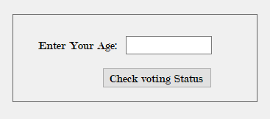
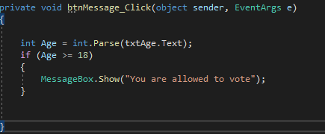
If Statement
The code behind the button is this, from this code it checks what the user enters inside the textbox, if the number entered is 18 and above then message that will be produced is “You are allowed to vote”

Slide 12
When writing the if statements they are written with the help of conditional operators.
> Greater Than
< Less Than
>= Greater Than or Equal To
<= Less than or Equal To
!= Not Equal To
! Not
&& And
|| Or
= = Equal To

Slide 13
If statement contd..
In the code written earlier if one enters 15 as their age then no message is going to be displayed based on how the code is at the moment. What we want to do is modify our code slightly. If one enters
0 – 17 let the system display you are too young to vote,
18 – 120 You are allowed to vote,
Above 120 – age not included in this exercise
Negative number – please enter valid age in the text box.
For this to happen we will add an else if part whereby we will give the conditions that we want for our system.

Slide 14
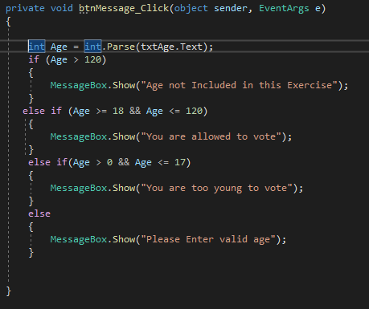
If statement contd..

Slide 15
2. Switch statement

Slide 16
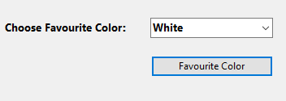
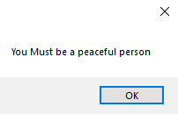
switch Statement
The second conditional logic is the switch statement. To understand the switch statement, we are going to build a small program using the drop-down button. Our Graphical User Interface will look like this.

Slide 17
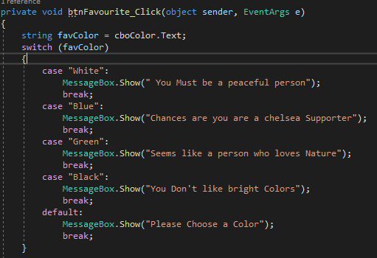
switch Statement
When one clicks on the drop-down arrow and chooses their favorite color, then clicks on the button appropriate message will be displayed on the message box. Below we have the code that is going to give us the output shown above.

